Slide 1
Cross Site Scripting found in http://zero.webappsecurity.com/help.html

Slide 2
Vulnerability description:-
This script is possibly vulnerable to Cross Site Scripting (XSS) attacks.
Cross site scripting (also referred to as XSS) is a vulnerability that allows an attacker to send malicious code
(usually in the form of Javascript) to another user. Because a browser cannot know if the script should be trusted or not,
it will execute the script in the user context allowing the attacker to access any cookies or session tokens retained

Slide 3
The impact of this vulnerability
Malicious users may inject JavaScript, VBScript, ActiveX, HTML or Flash into a vulnerable application to fool a user in order
to gather data from them. An attacker can steal the session cookie and take over the account, impersonating the user.
It is also possible to modify the content of the page presented to the user.
The impact of cross-site scripting vulnerabilities can vary from one web application to another. It ranges from session hijacking to credential theft and other security vulnerabilities. By exploiting a cross-site scripting vulnerability, an attacker can impersonate a legitimate user and take over their account.

Slide 4
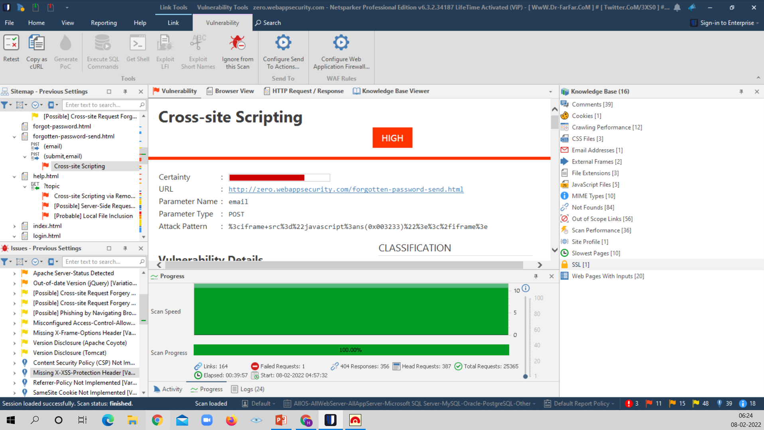
Cross-site Scripting
Screenshot of Netsparker

Slide 5
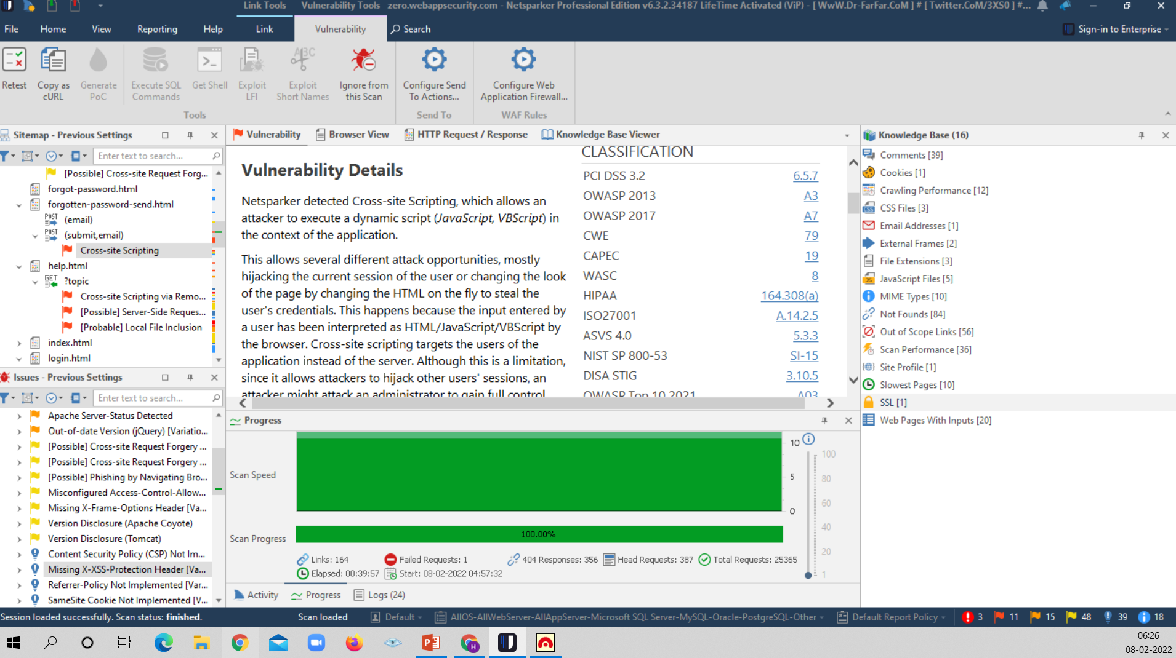

Slide 6
